Slide 1

Introduction to Robotics
CSE 461
Chapter 2: Lecture 6 (Forward Kinematics)
Niloy Irtisam
Lecturer, Dept. of Computer Science and Engineering
BRAC University

Slide 2
Last Class
Kinematics
Degrees of Freedom (DOF)
D-H Parameters

Slide 3
Recall D-H Parameters

Slide 4
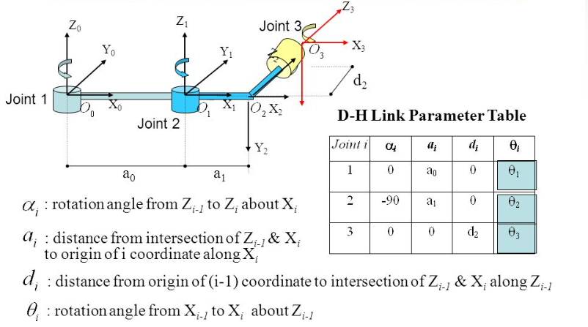
D-H Parameters

Slide 5
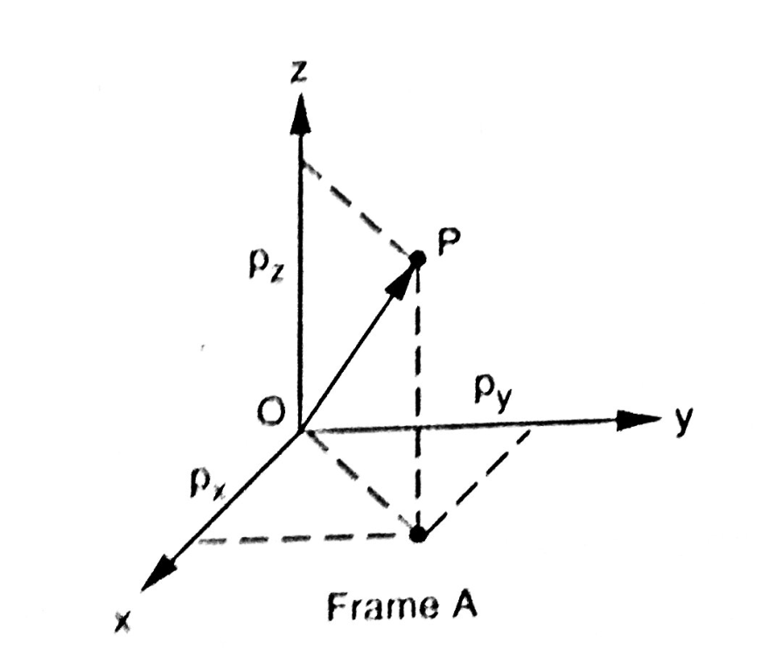
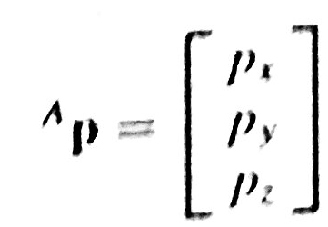
Position

Slide 6
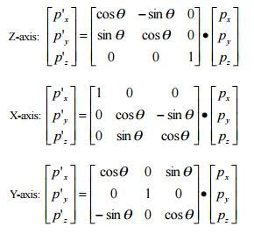
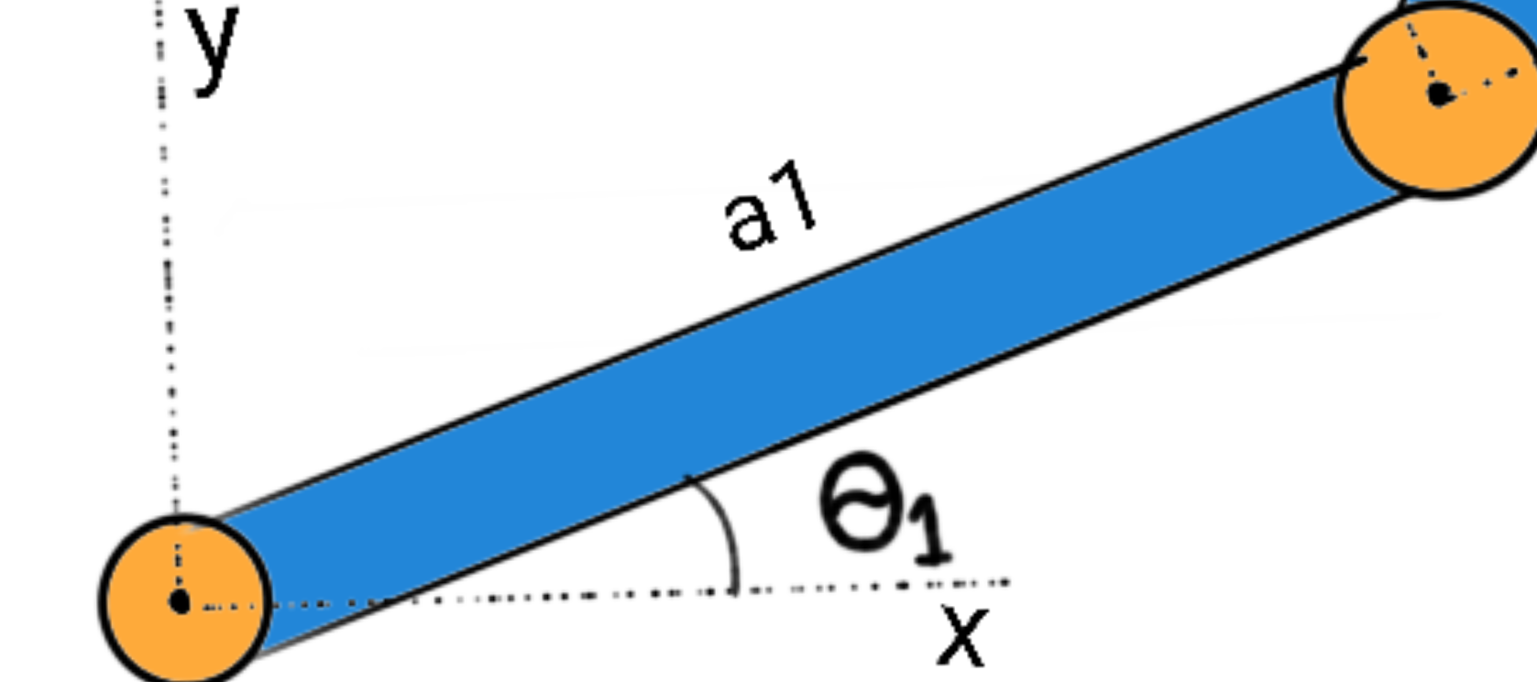
Rotation

Slide 7
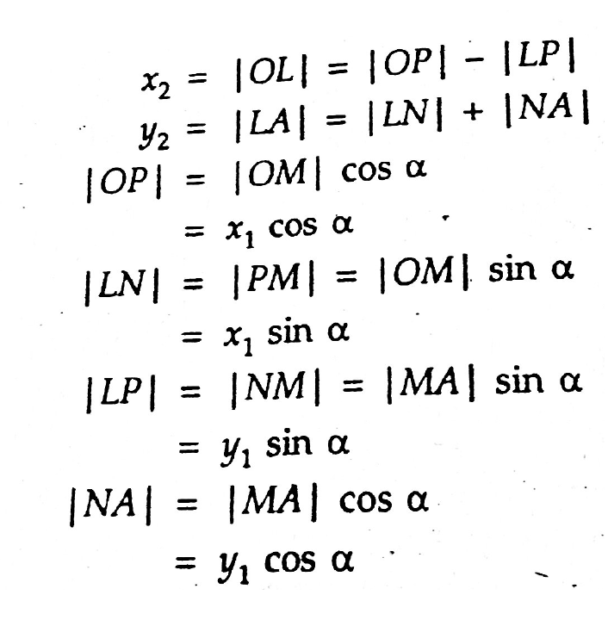
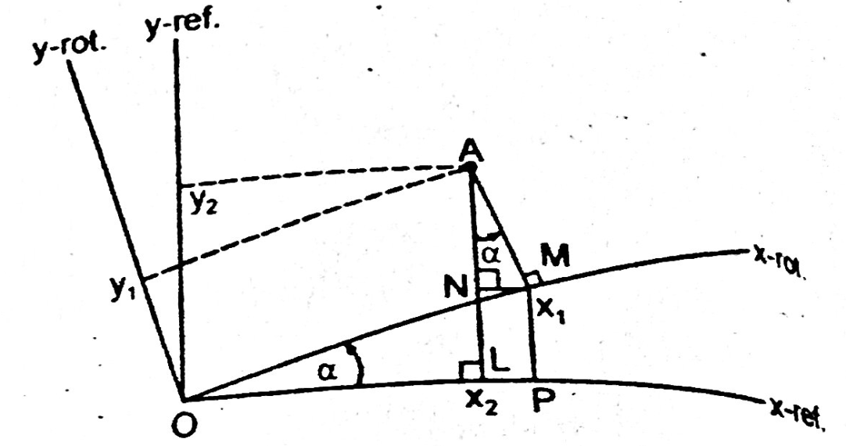
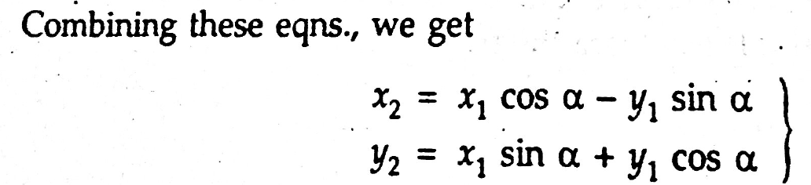
Rotation

Slide 8
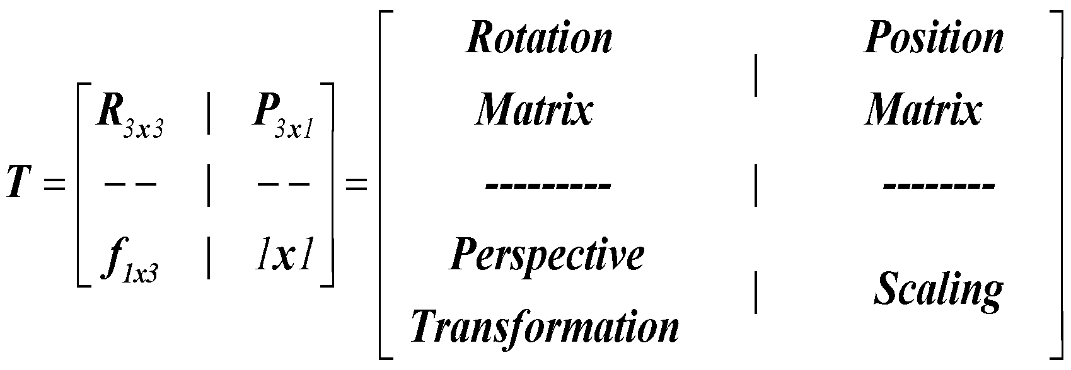
Homogeneous Transformation Matrix
Homogeneous Transformation Matrices are commonly used to represent linkages (for robot arm) in a systematic way for representing Position Vector and Rotation Matrices {4X4 Matrix}.

Slide 9
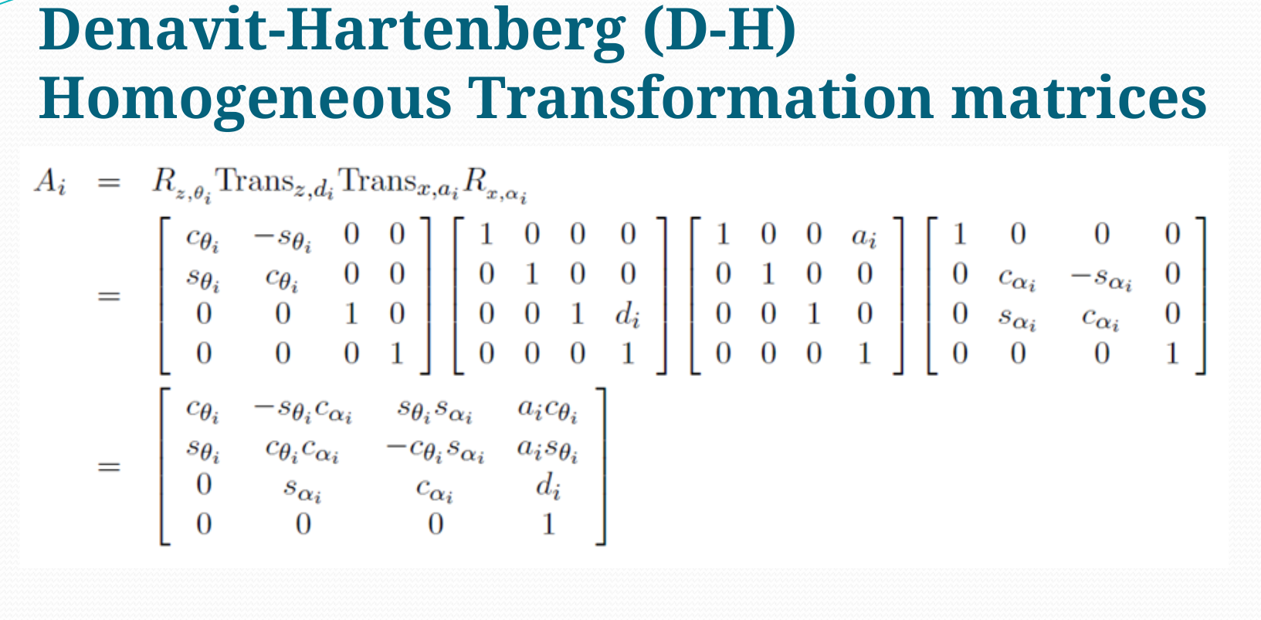

Slide 10
D-H Parameters

Slide 11
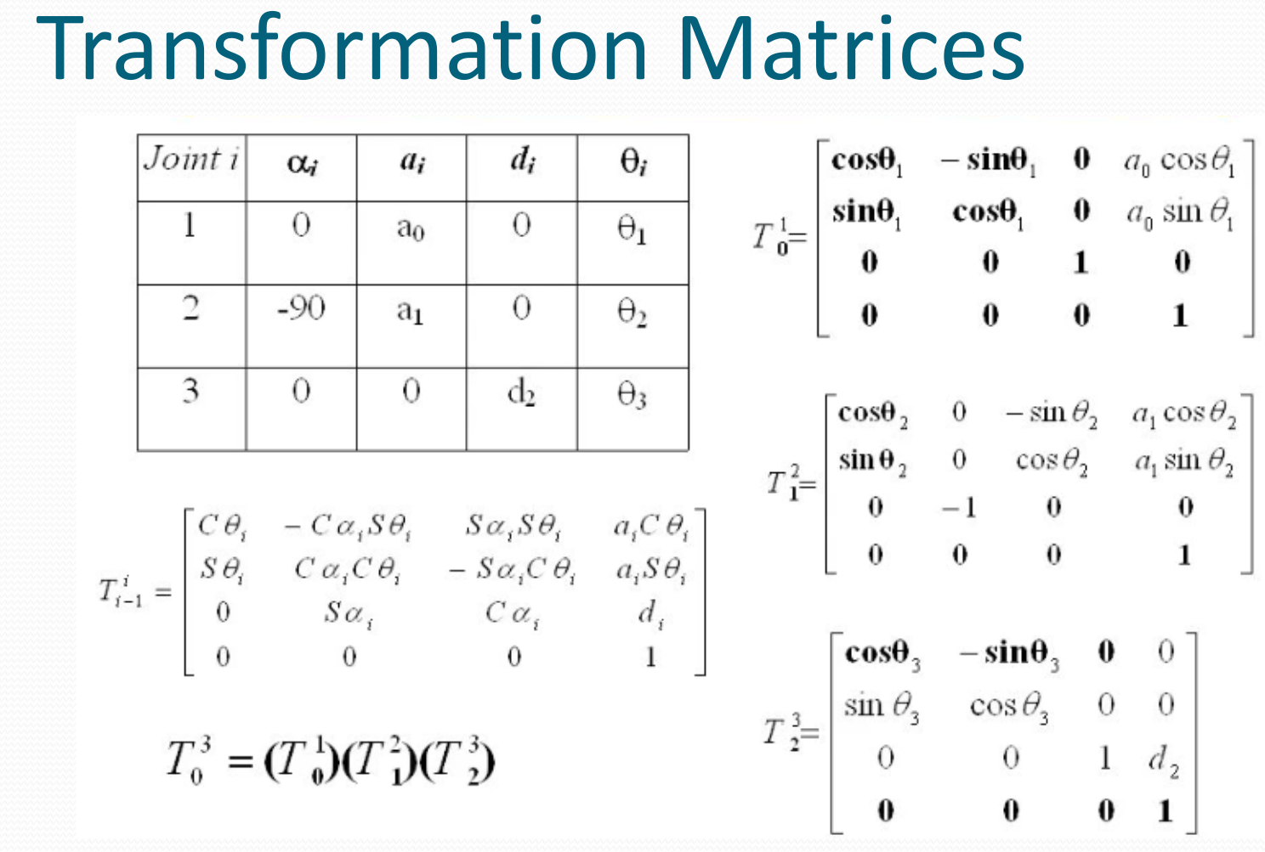

Slide 12
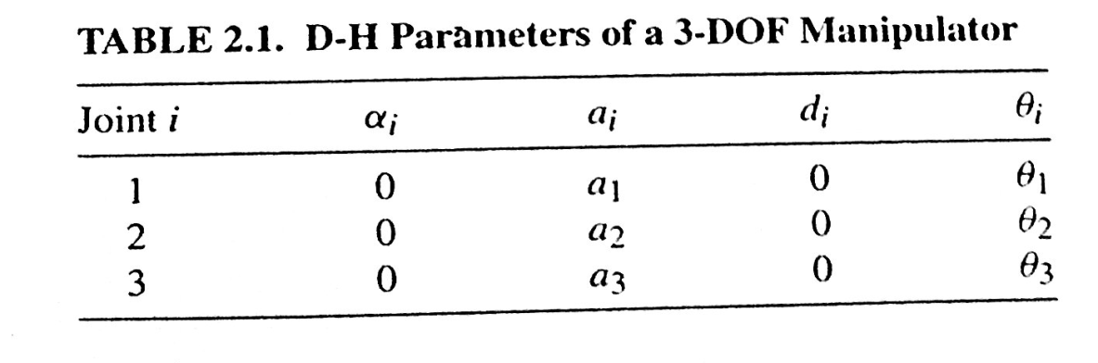
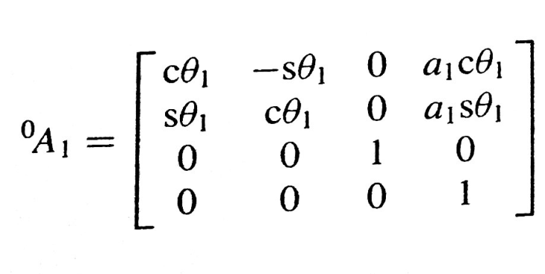
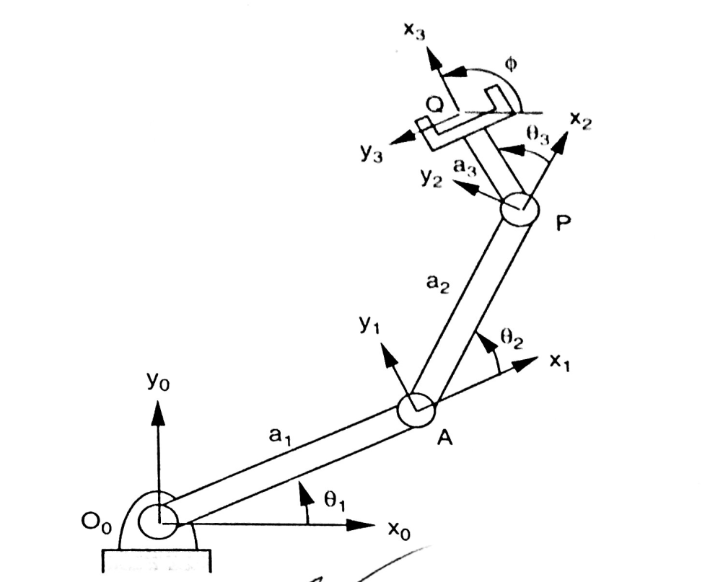
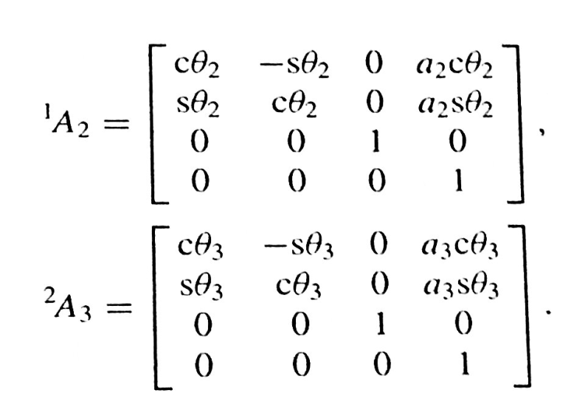
Forward Kinematics

Slide 13
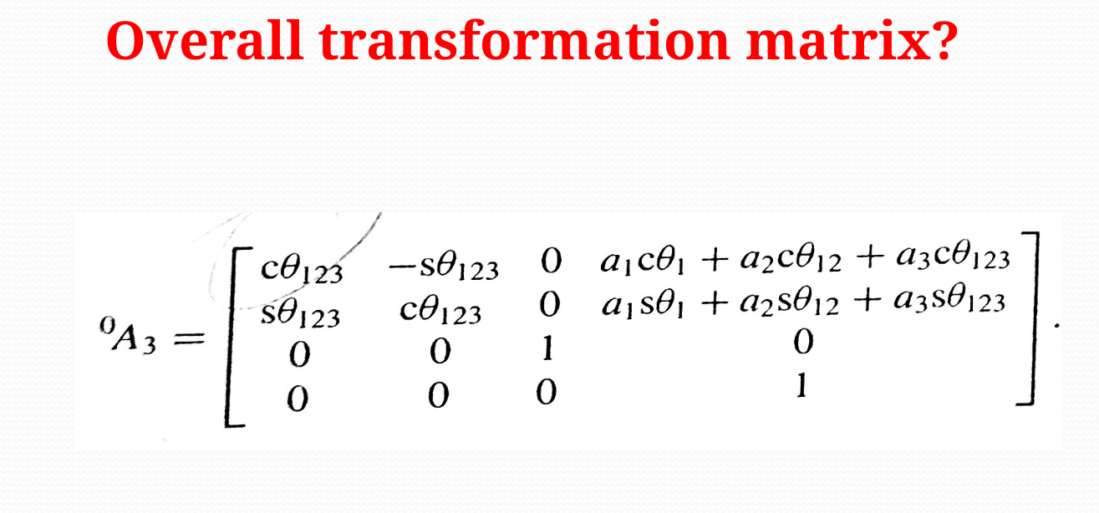

Slide 14
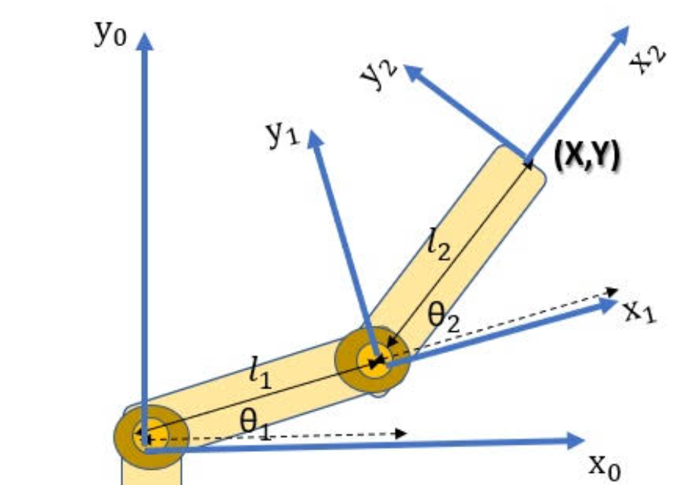
Position
Orientation

Slide 15
Steps
Define z axis
Define x,y using R.H rule

Slide 16
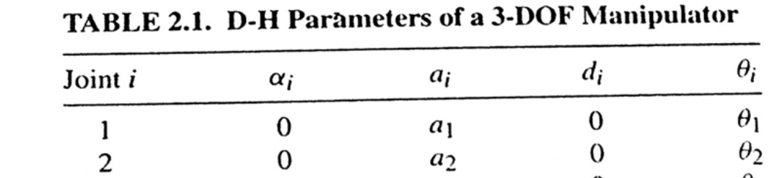
Steps
Define z axis
Define x,y using R.H rule
Calculate D-H parameters

Slide 17
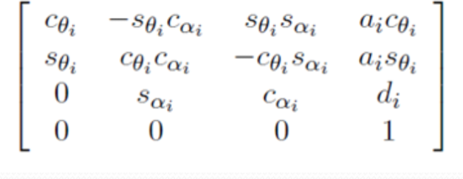
Steps
Define z axis
Define x,y using R.H rule
Calculate D-H parameters
Put the parameters to the homogeneous transformation matrices

Slide 18
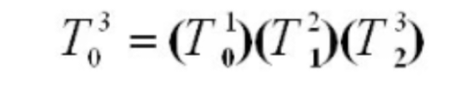
Steps
Define z axis
Define x,y using R.H rule
Calculate D-H parameters
Put the parameters to the homogeneous transformation matrices
Multiply for each joints

Slide 19

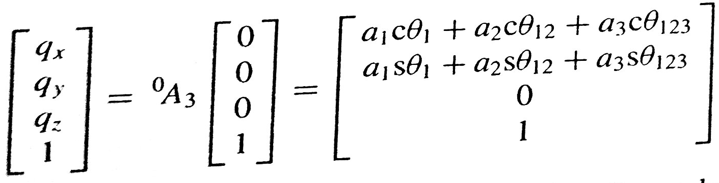
Forward Kinematics
Initial position vector :
Final position vector?

Slide 20
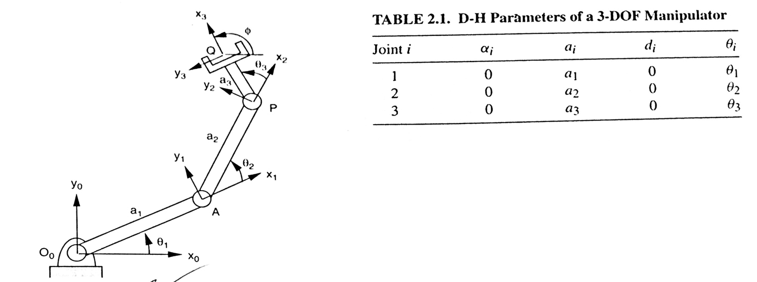
Assignment: Calculate position of end effector of this 3 DOF Manipulator
Angles of three joints are 30 degree, 45 degree and 10 degree.
a₁ = 10
a₂ = 8 a₃ = 3

Slide 21
Next class
Inverse Kinematics

Slide 22
Thanks

